Slide 1

DATA SCIENCE USING PYTHON Industrial Training Presentation Date: 28/09/2024
BCA(BCA001)
Degree : BCA <Bachelor Of Computer Application>
Presented By:
Ishika Sharma (TCA2201257)
External Project Guide:
Ms. Anjana Tiwari
Company Name:
DUCAT
Internal Project Guide:
Mr. Maneet Siddhu
Department Name:
CCSIT
COLLEGE OF COMPUTING SCIENCES AND INFORMATION TECHNOLOGY
TEERTHANKER MAHAVEER UNIVERSITY, MORADABAD

Slide 2

Agenda
Brief on “Company Profile”
Project Introduction
Project Description
Results & Findings
Suggestions & Recommendations
Conclusion
T012D/ Template Version 5.0

Slide 3

DUCAT
DUCAT is a Registered IT Training Institute. Which train students from both local and PAN India in a variety of nationally recognised professional IT courses.
With their streamlined and adaptable course delivery model, we ensure that you thoroughly grasp the information and develop useful skills in your selected course.
T012D/ Template Version 5.0

Slide 4
Project Introduction
The rapid growth of online streaming platforms has led to an overwhelming number of movies available to viewers. This abundance can make it difficult for users to discover new content that aligns with their preferences. Consequently, there is a need for a robust and efficient movie recommendation system to help users navigate this vast library and find movies they are likely to enjoy.
The primary goal of this project is to develop a movie recommendation system that can accurately predict user preferences and provide personalized recommendations.
T012D/ Template Version 5.0

Slide 5
Project Description:
The Movie Recommendation System is a machine learning-based application that provides personalized movie recommendations to users. It utilizes collaborative filtering techniques to analyze user preferences and similarities among movies to generate accurate and relevant recommendations. The system is built using Python programming language and incorporates popular machine learning libraries such as Scikit-learn, NumPy and Pandas.
Recommend movies that are highly likely to be enjoyed by specific users based on their preferences and historical viewing behavior.
T012D/ Template Version 5.0

Slide 6
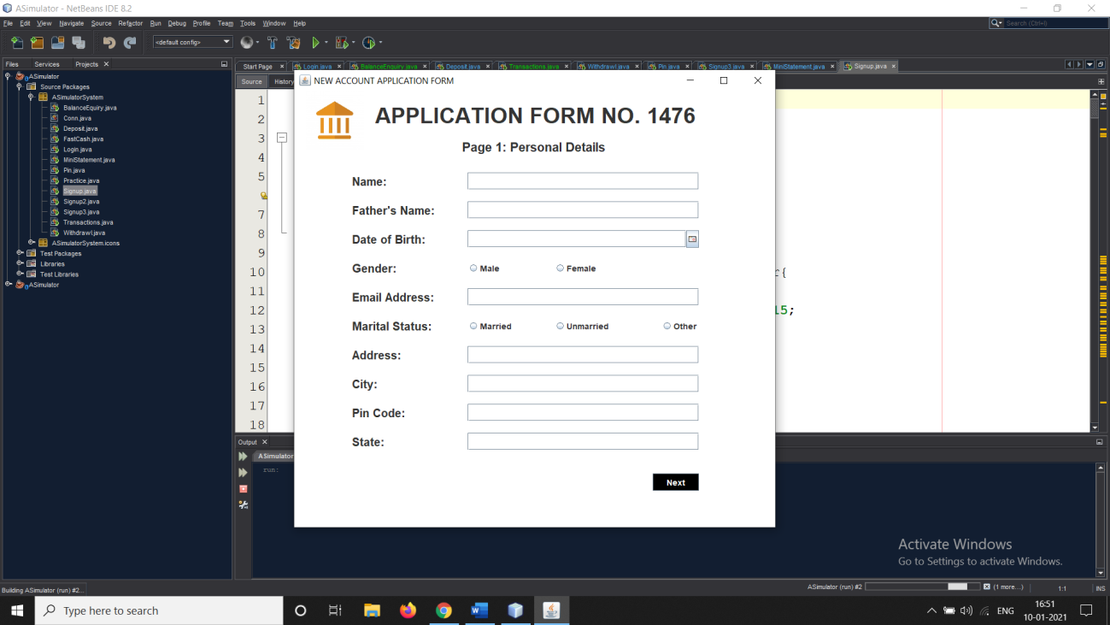
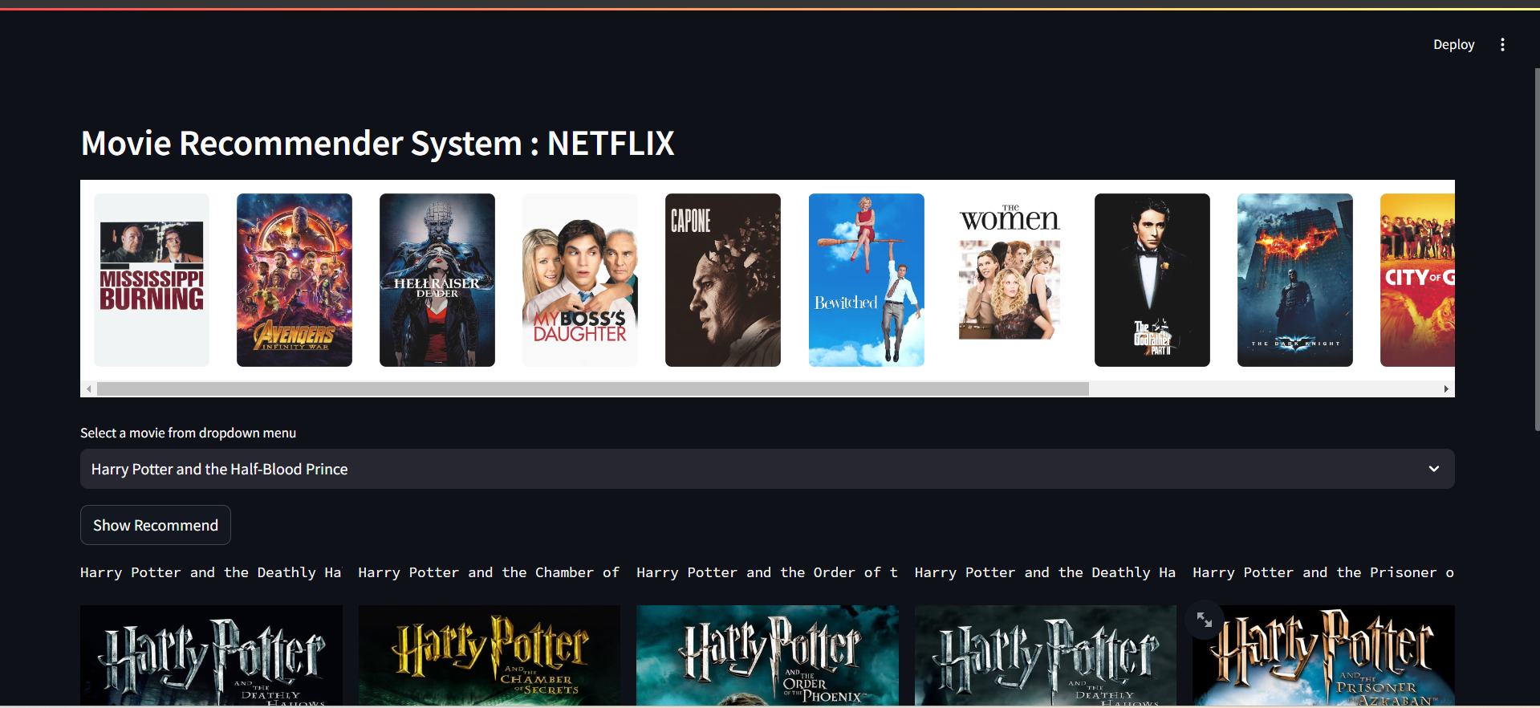
Preview Pic 1
T012D/ Template Version 5.0

Slide 7
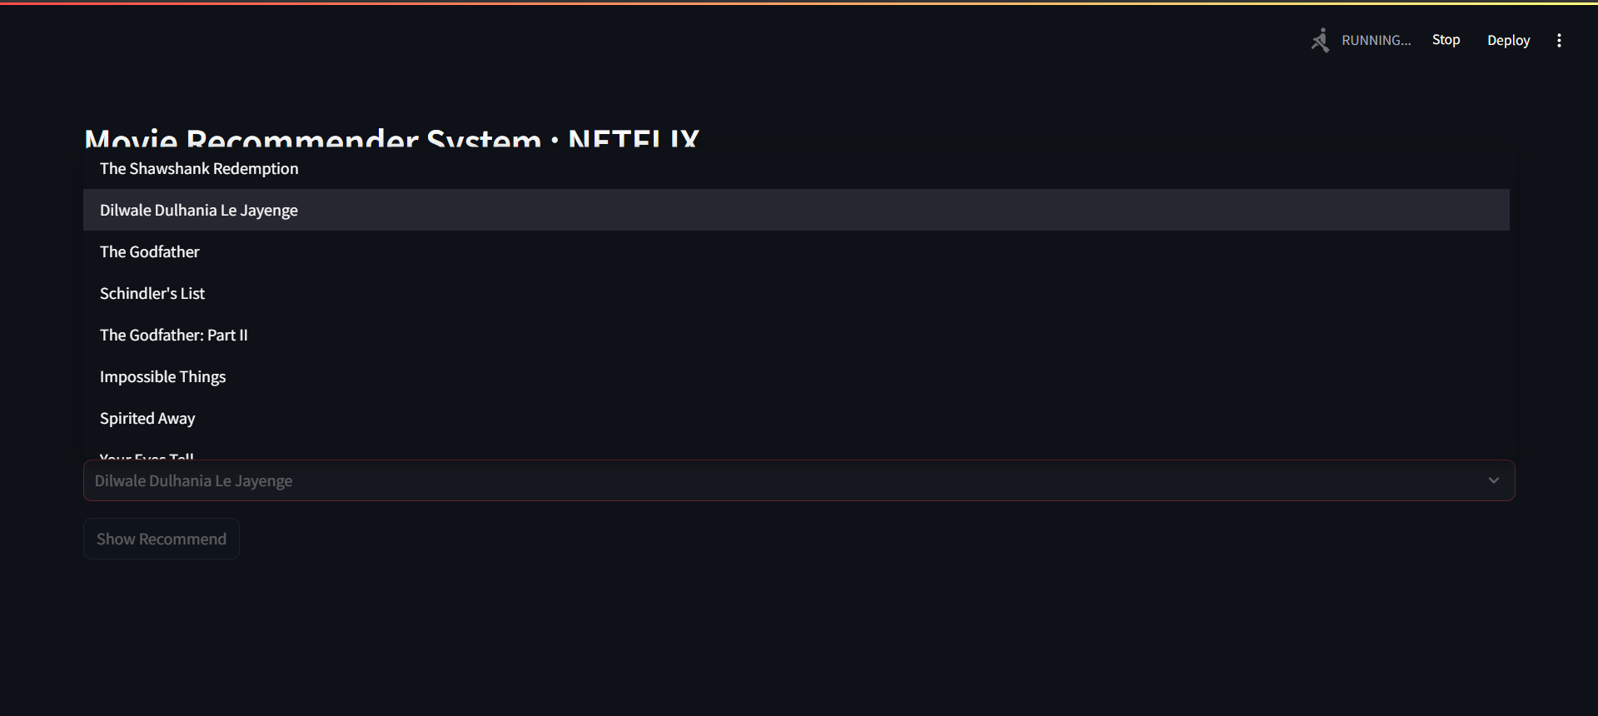
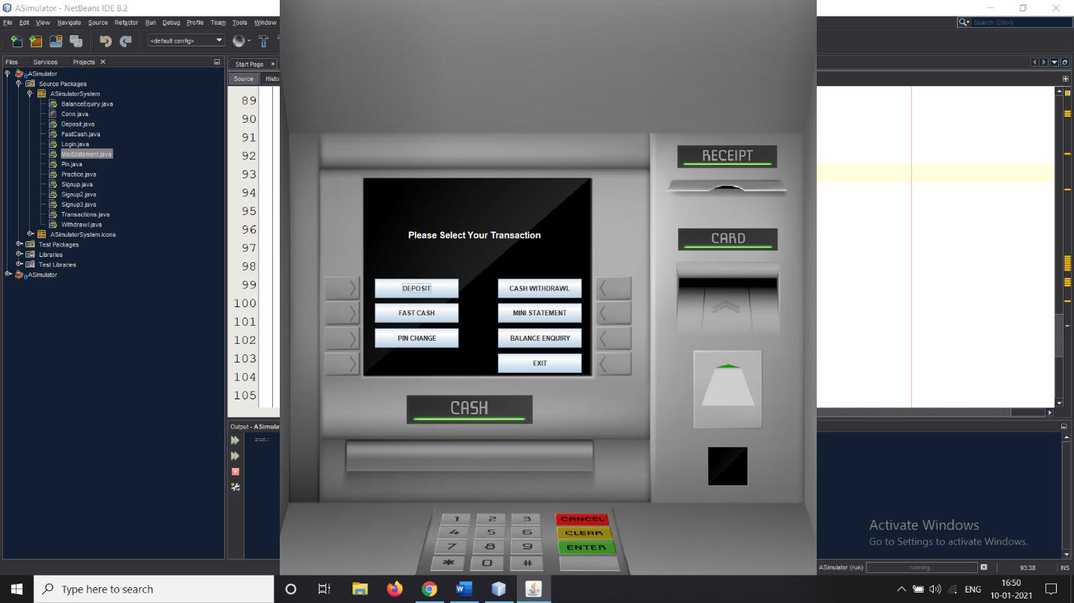
Preview Pic 2
T012D/ Template Version 5.0

Slide 8
Suggestions & Future Scope
1. Advanced Personalization: Incorporate deep learning models like neural collaborative filtering for more accurate, context-aware recommendations. Use natural language processing (NLP) to analyze user reviews andmovie content, improving recommendation relevance.
2. Multi-Modal Recommendations: Extend recommendations to include multiple language movies, web series, or tv shows, offering a broader content variety.
3. Real-Time Recommendations: Implement real-time recommendation updates based on user behavior during browsing sessions for improved engagement.
4. Cross-Platform Integration: Integrate with social media platforms, allowing users to share and receive recommendations from friends or influencers.
T012D/ Template Version 5.0

Slide 9
.00.
Conclusion
Users can quickly discover new movies they might enjoy without having to spend hours browsing through catalogs.
Recommenders can introduce users to movies they might not have considered otherwise, expanding their horizons.
A well-designed recommender system can enhance the overall user experience by making it easier to find and enjoy movies.
Movies are recommended based on the cosine similarity of the overview.
T012D/ Template Version 5.0

Slide 10
THANKS YOU
T004/ Version 1.0

